Slide 1

Department of Computer Science
University Institute of Engineering
DEPARTMENT OF COMPUTER SCIENCE & ENGINEERING
Bachelor of Engineering
Subject Name: System Programming
Subject Code: CST-281
Compilers
DISCOVER . LEARN . EMPOWER

Slide 2
Chapter-2.2
Scanning & parsing
Department of computer Science
Bottom Up Parser

Slide 3
Bottom-Up Parsers
A bottom-up parser constructs a parse tree by beginning at the leaves and progressing toward the root.
Bottom-up parsing starts from the leaf nodes of a tree and works in upward direction till it reaches the root node.
Here, we start from a sentence and then apply production rules in reverse manner in order to reach the start symbol.
The image given below depicts the bottom-up parsers available.

Slide 4
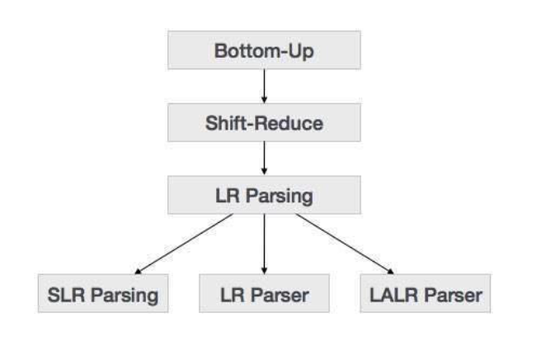
Bottom-Up Parsers

Slide 5
Shift-Reduce Parsing
Shift-reduce parsing uses two unique steps for bottom-up parsing. These steps are known as shift-step and reduce-step.
Shift step: The shift step refers to the advancement of the input pointer to the next input symbol, which is called the shifted symbol.
This symbol is pushed onto the stack. The shifted symbol is treated as a single node of the parse tree.

Slide 6
Shift-Reduce Parsing
Reduce step : When the parser finds a complete grammar rule (RHS) and replaces it to (LHS), it is known as reduce-step.
This occurs when the top of the stack contains a handle.
To reduce, a POP function is performed on the stack which pops off the handle and replaces it with LHS non-terminal symbol.

Slide 7
LR Parser
The LR parser is a non-recursive, shift-reduce, bottom-up parser.
It uses a wide class of context-free grammar which makes it the most efficient syntax analysis technique.
LR parsers are also known as LR(k) parsers, where L stands for left-to-right scanning of the input stream; R stands for the construction of right-most derivation in reverse, and k denotes the number of look ahead symbols to make decisions.

Slide 8
LR Parser
There are three widely used algorithms available for constructing an LR parser:
SLR(1) – Simple LR Parser:
Works on smallest class of grammar
Few number of states, hence very small table
Simple and fast construction

Slide 9
LR Parser
LR(1) – LR Parser:
Works on complete set of LR(1) Grammar
Generates large table and large number of states
Slow construction

Slide 10
LR Parser
LALR(1) – Look-Ahead LR Parser:
Works on intermediate size of grammar
Number of states are same as in SLR(1)

Slide 11
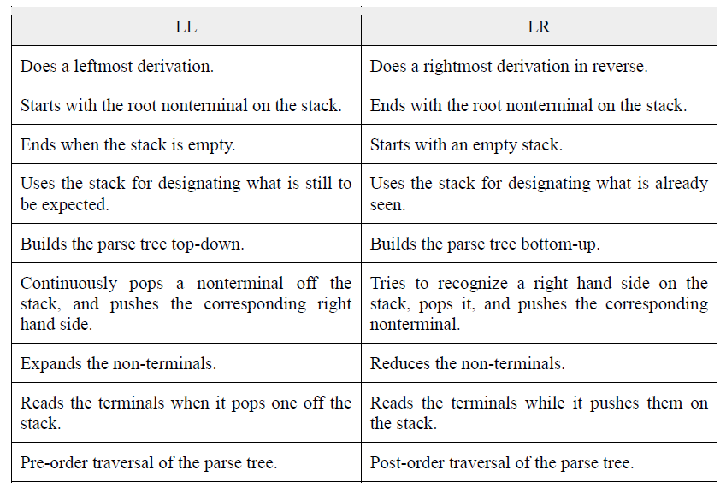
LL vs. LR

Slide 12
References
Department of computer Science
[PDF] Systems Programming and Operating Systems by Dhamdhere - Free Download PDF (dlscrib.com)
[PDF] Principles of Compiler Design By Alfred V. Aho & J.D.Ullman Free Download – Learnengineering.in

Slide 13
THANK YOU

